Slide 1
TAS152
LECTURE 12
TOPIC 2
ETHICS IN THE INFORMATION SOCIETY
2.5 PRIVACY: DIGNITY, DATA MINING AND SECURITY

Slide 2
PRIVACY
The United Nations has recognised the protection of privacy as a human right
The right to privacy needs to be balanced against open access to information, community rights and security needs.
Governments need to balance the protection of public security against respect for the privacy of individuals.
Unfortunately, there is no simple formula that can be applied to resolve this balance.

Slide 3
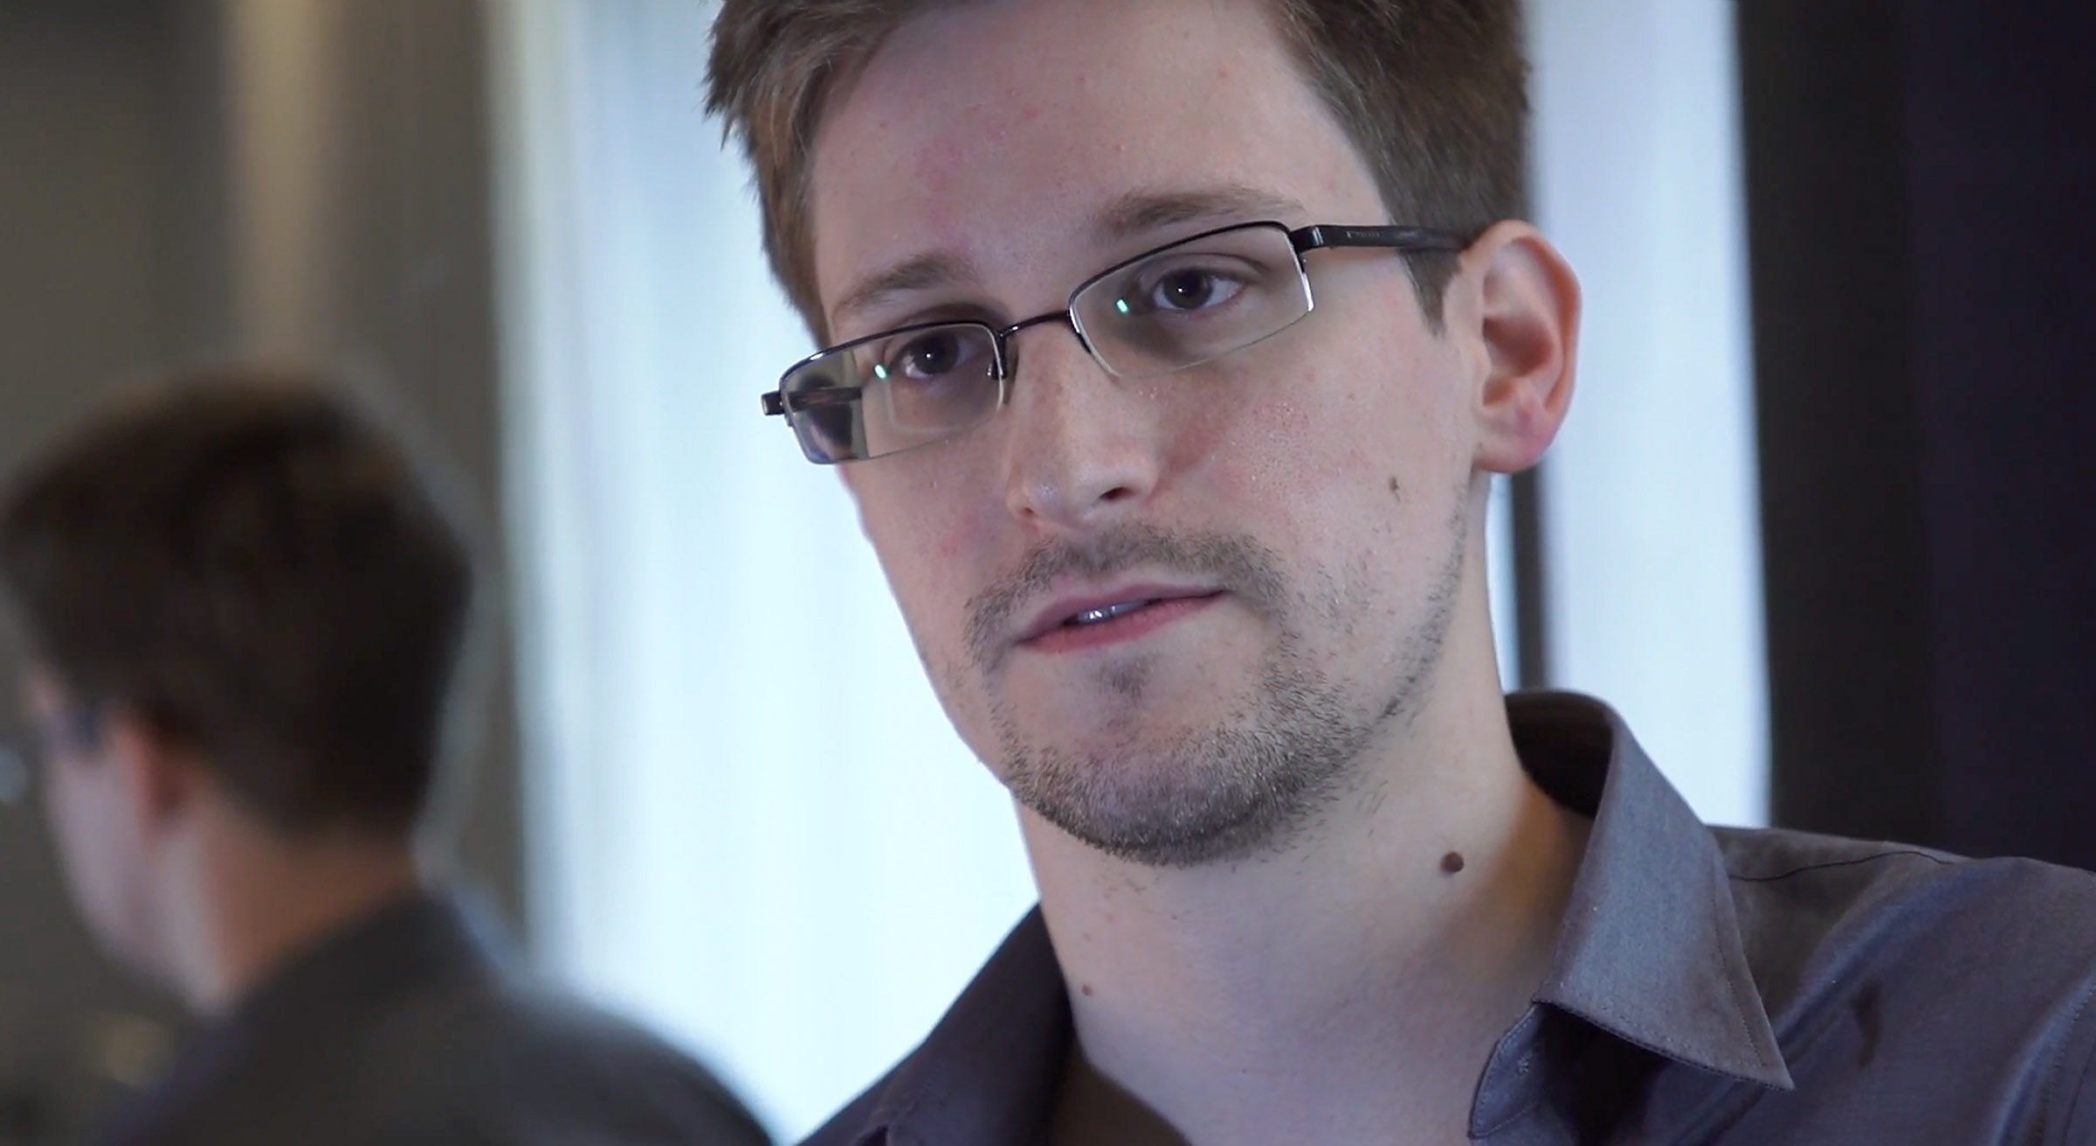
HOW WHISTLEBLOWERS SUPPORT PRIVACY
Edward Snowden was employed by the National Security Agency (NSA),
The NSA is an American government agency that is responsible for conducting surveillance in the interest of protecting the public.
In 2013 Snowden leaked classified documents revealing that the NSA has been illegally conducting extremely invasive surveillance.
Mostly targeted at average American citizens and journalists.
In a recent 2023 interview Snowden states that recent advances in artificial intelligence have contributed to surveillance technologies becoming even more advanced than what he had described in 2013 (MacAskill, 2023).

Slide 4

POPIA
Protection of Personal Information Act (PoPIA)
Eight key principles:
Transparency
Lawful collection
Compliance with regulation
Security
Participation
Information quality
Limited use
Limited processing
Tiger Licking Coffee S.P.I.L.L

Slide 5
POPIA
Recent developments wrt POPIA
https://www.timeslive.co.za/news/south-africa/2024-03-26-saps-and-iec-to-be-probed-for-popi-act-breaches/
https://www.sabcnews.com/sabcnews/irsa-concerned-about-political-parties-compliance-with-popia/
https://www.itweb.co.za/article/dis-chem-hits-back-at-popia-violation-enforcement-notice/KBpdg7pm9DgMLEew
https://mybroadband.co.za/news/government/526149-goodbye-annoying-spam-calls-offenders-could-face-fines-up-to-r10-million.html

